Slide 1
High level plan:
Library System
Application
User Interaction
Database
Table1
Search Form
Returns Form
Table2
Book (info) Availability/Borrow Form
Book Management (Donate or Delete)

Slide 2
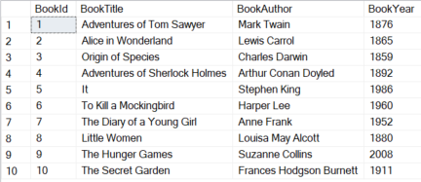
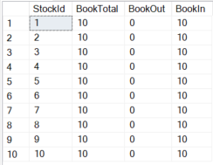
Details
Application
User Interaction
Database
Search Form
Returns a list of books or one book based on the TITLE:
Book Title
Returns Form
Table1
Table2
Book Management (Add or Delete)
When the user selects a book, then the systems shows the book details
Dbo.BookInfo
Dbo.BookStock
Non-user interaction
Book Details/ Availability
Book Title
Book Author
Copies Available

Slide 3
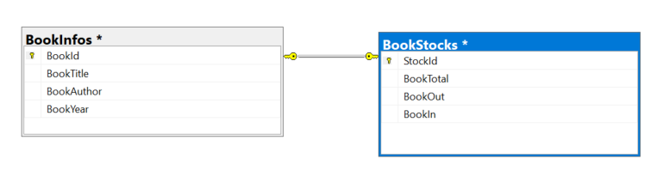
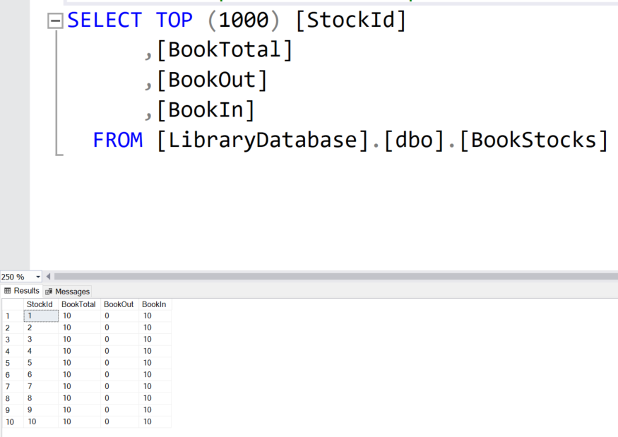
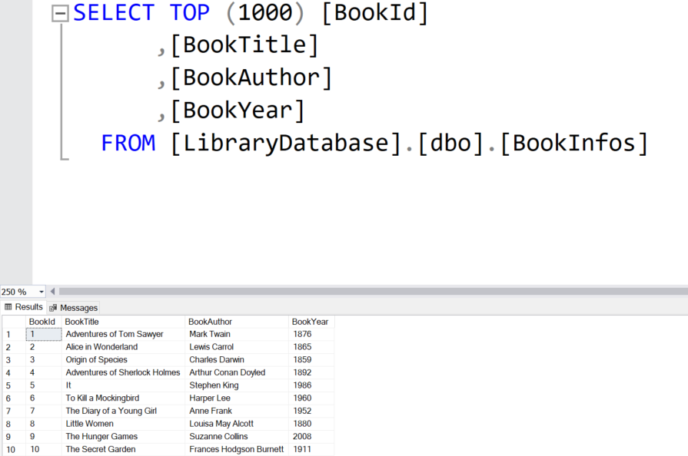
SQL Tables and Primary key mappings
1 to 1 mapping relationship
Database: Library Database
Table1: BookInfos (PK_BookInfos)
Table2: BookStocks (PL_BookStocks)

Slide 4
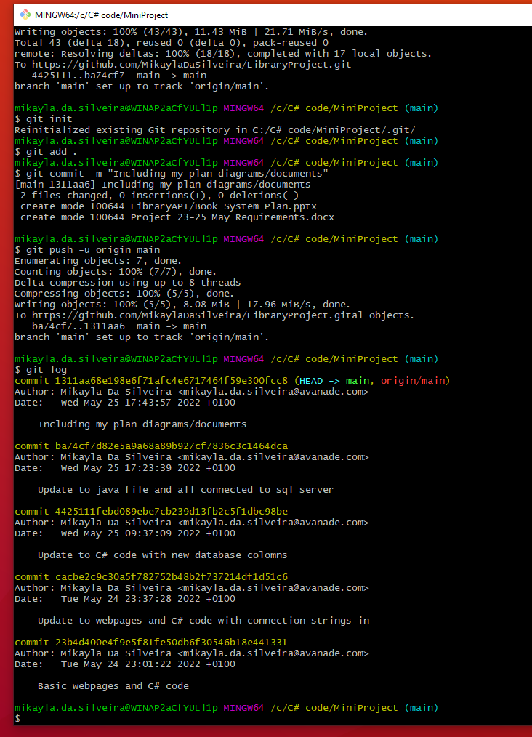
Adding my git commits to github

